Slide 1
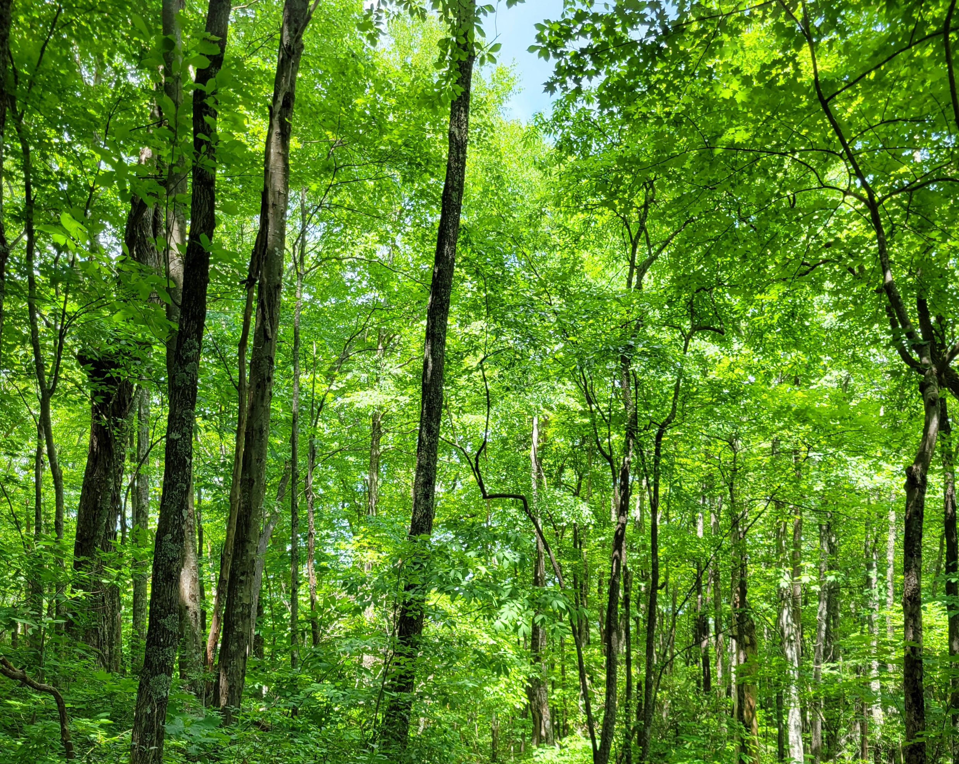
Regulation of nonstructural carbohydrate dynamics
Biological Insights from a Mathematical Analysis
Scott W Oswald, Doug P. Aubrey, Dan M. Ricciuto, Jeff M. Warren
Ecological Society of America, Montréal, QC
August 18, 2022

Slide 2
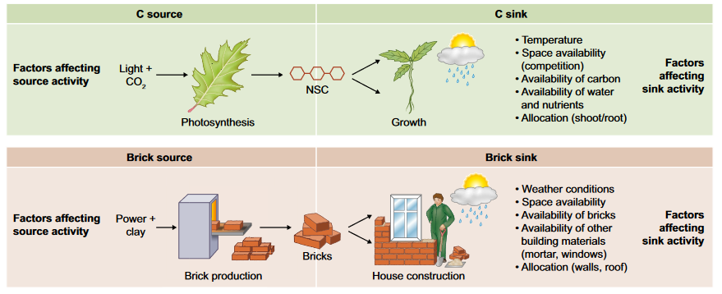
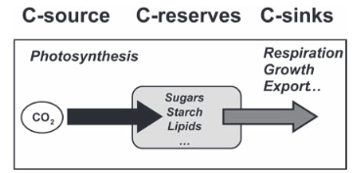
Fig 1. Fatichi et al. 2019
Nonstructural Carbohydrates = NSC
Sala et al. 2011; Sala et al. 2012

Slide 3
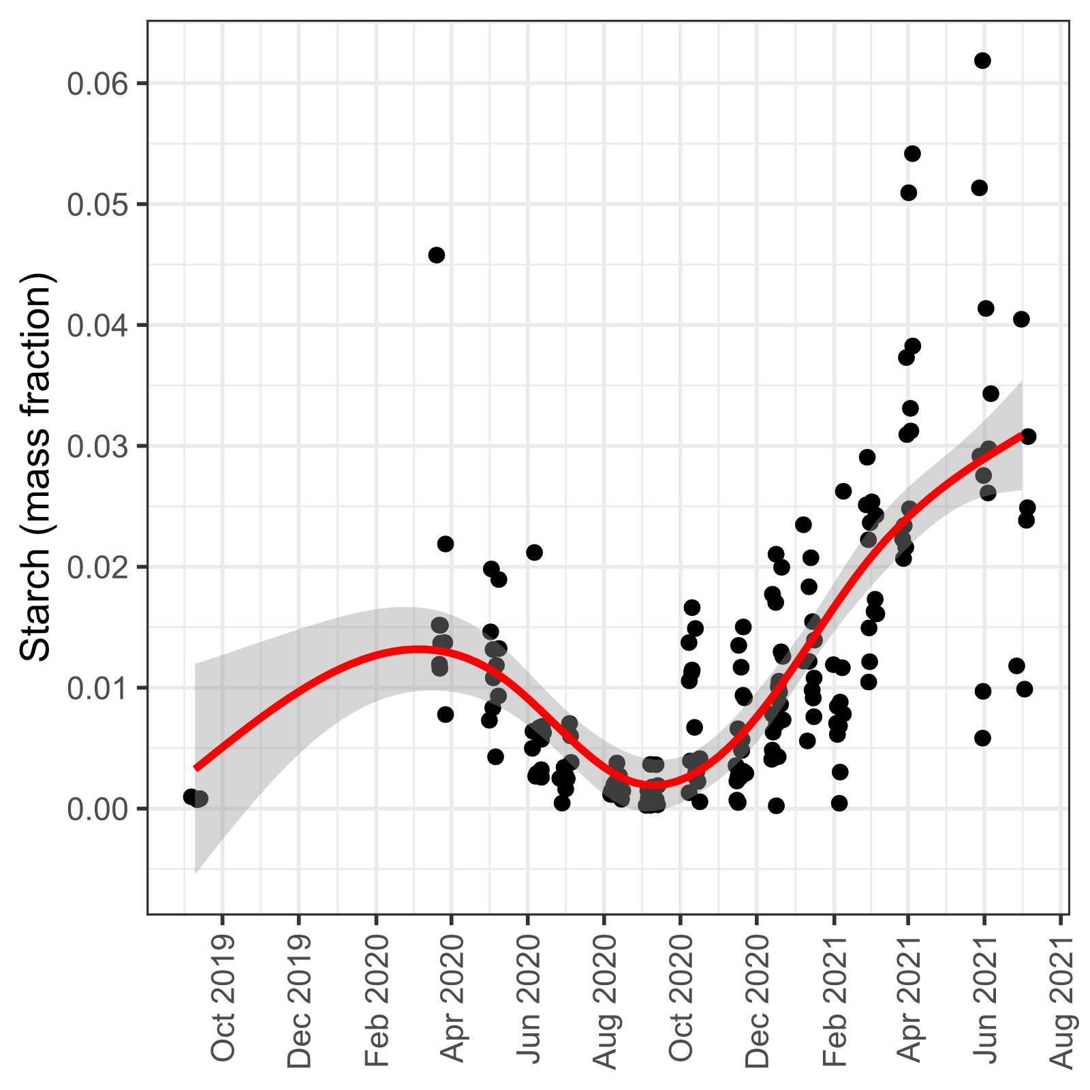
From here to there…

Slide 4
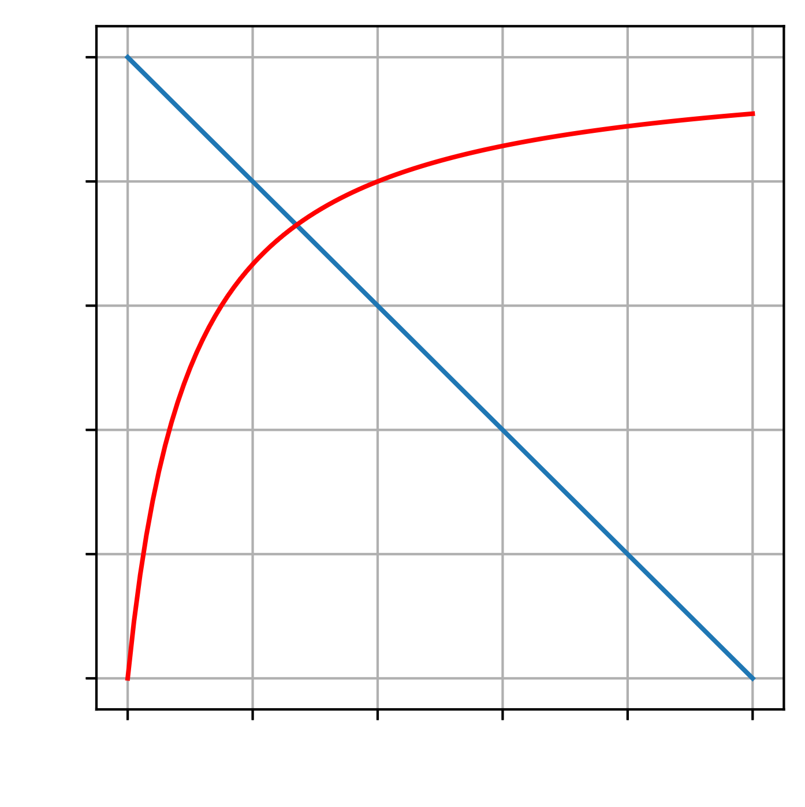
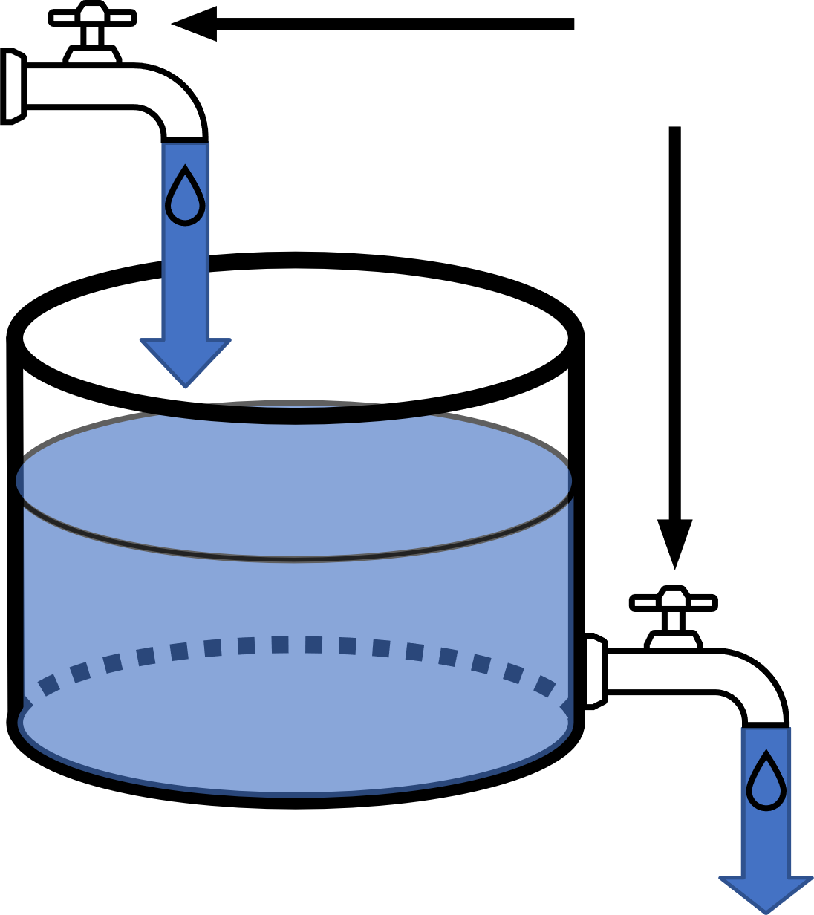
Photosynthesis
Demand Rate
Adjustable
Rate
Supply Rate
NSC
Respiration + Growth
NSC

Slide 5
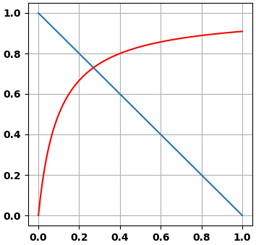
Photosynthesis
Adjustable
Rate
NSC
Respiration + Growth
NSC

Slide 6
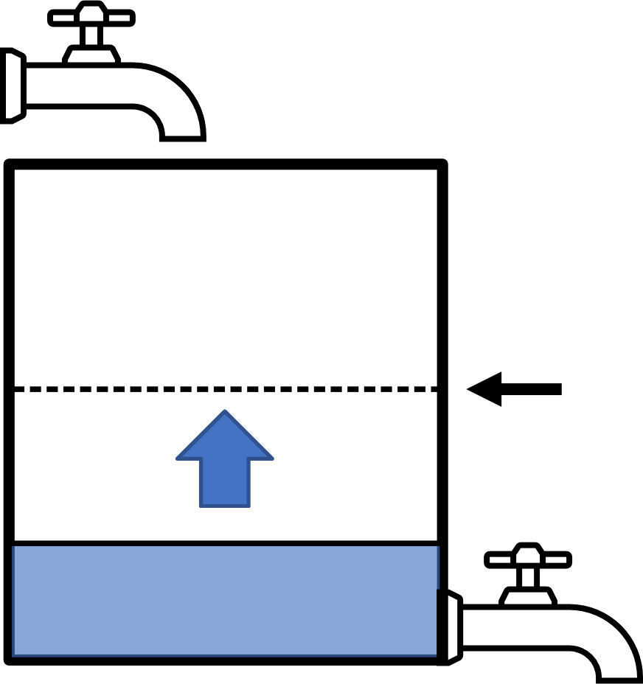
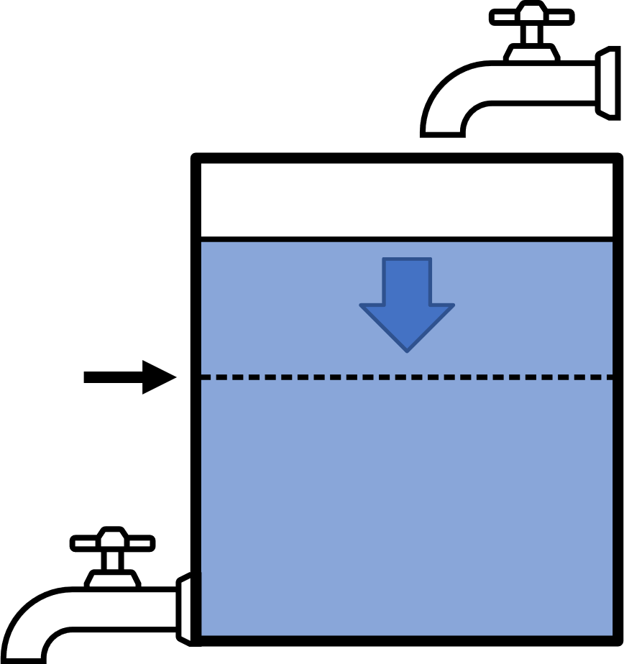
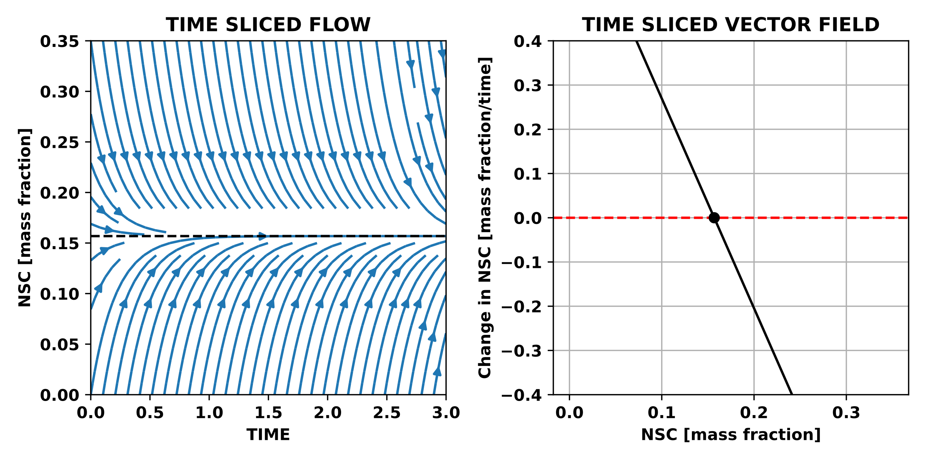
Balance point
Demand Rate
Rate
Supply Rate
Balance point
NSC

Slide 7
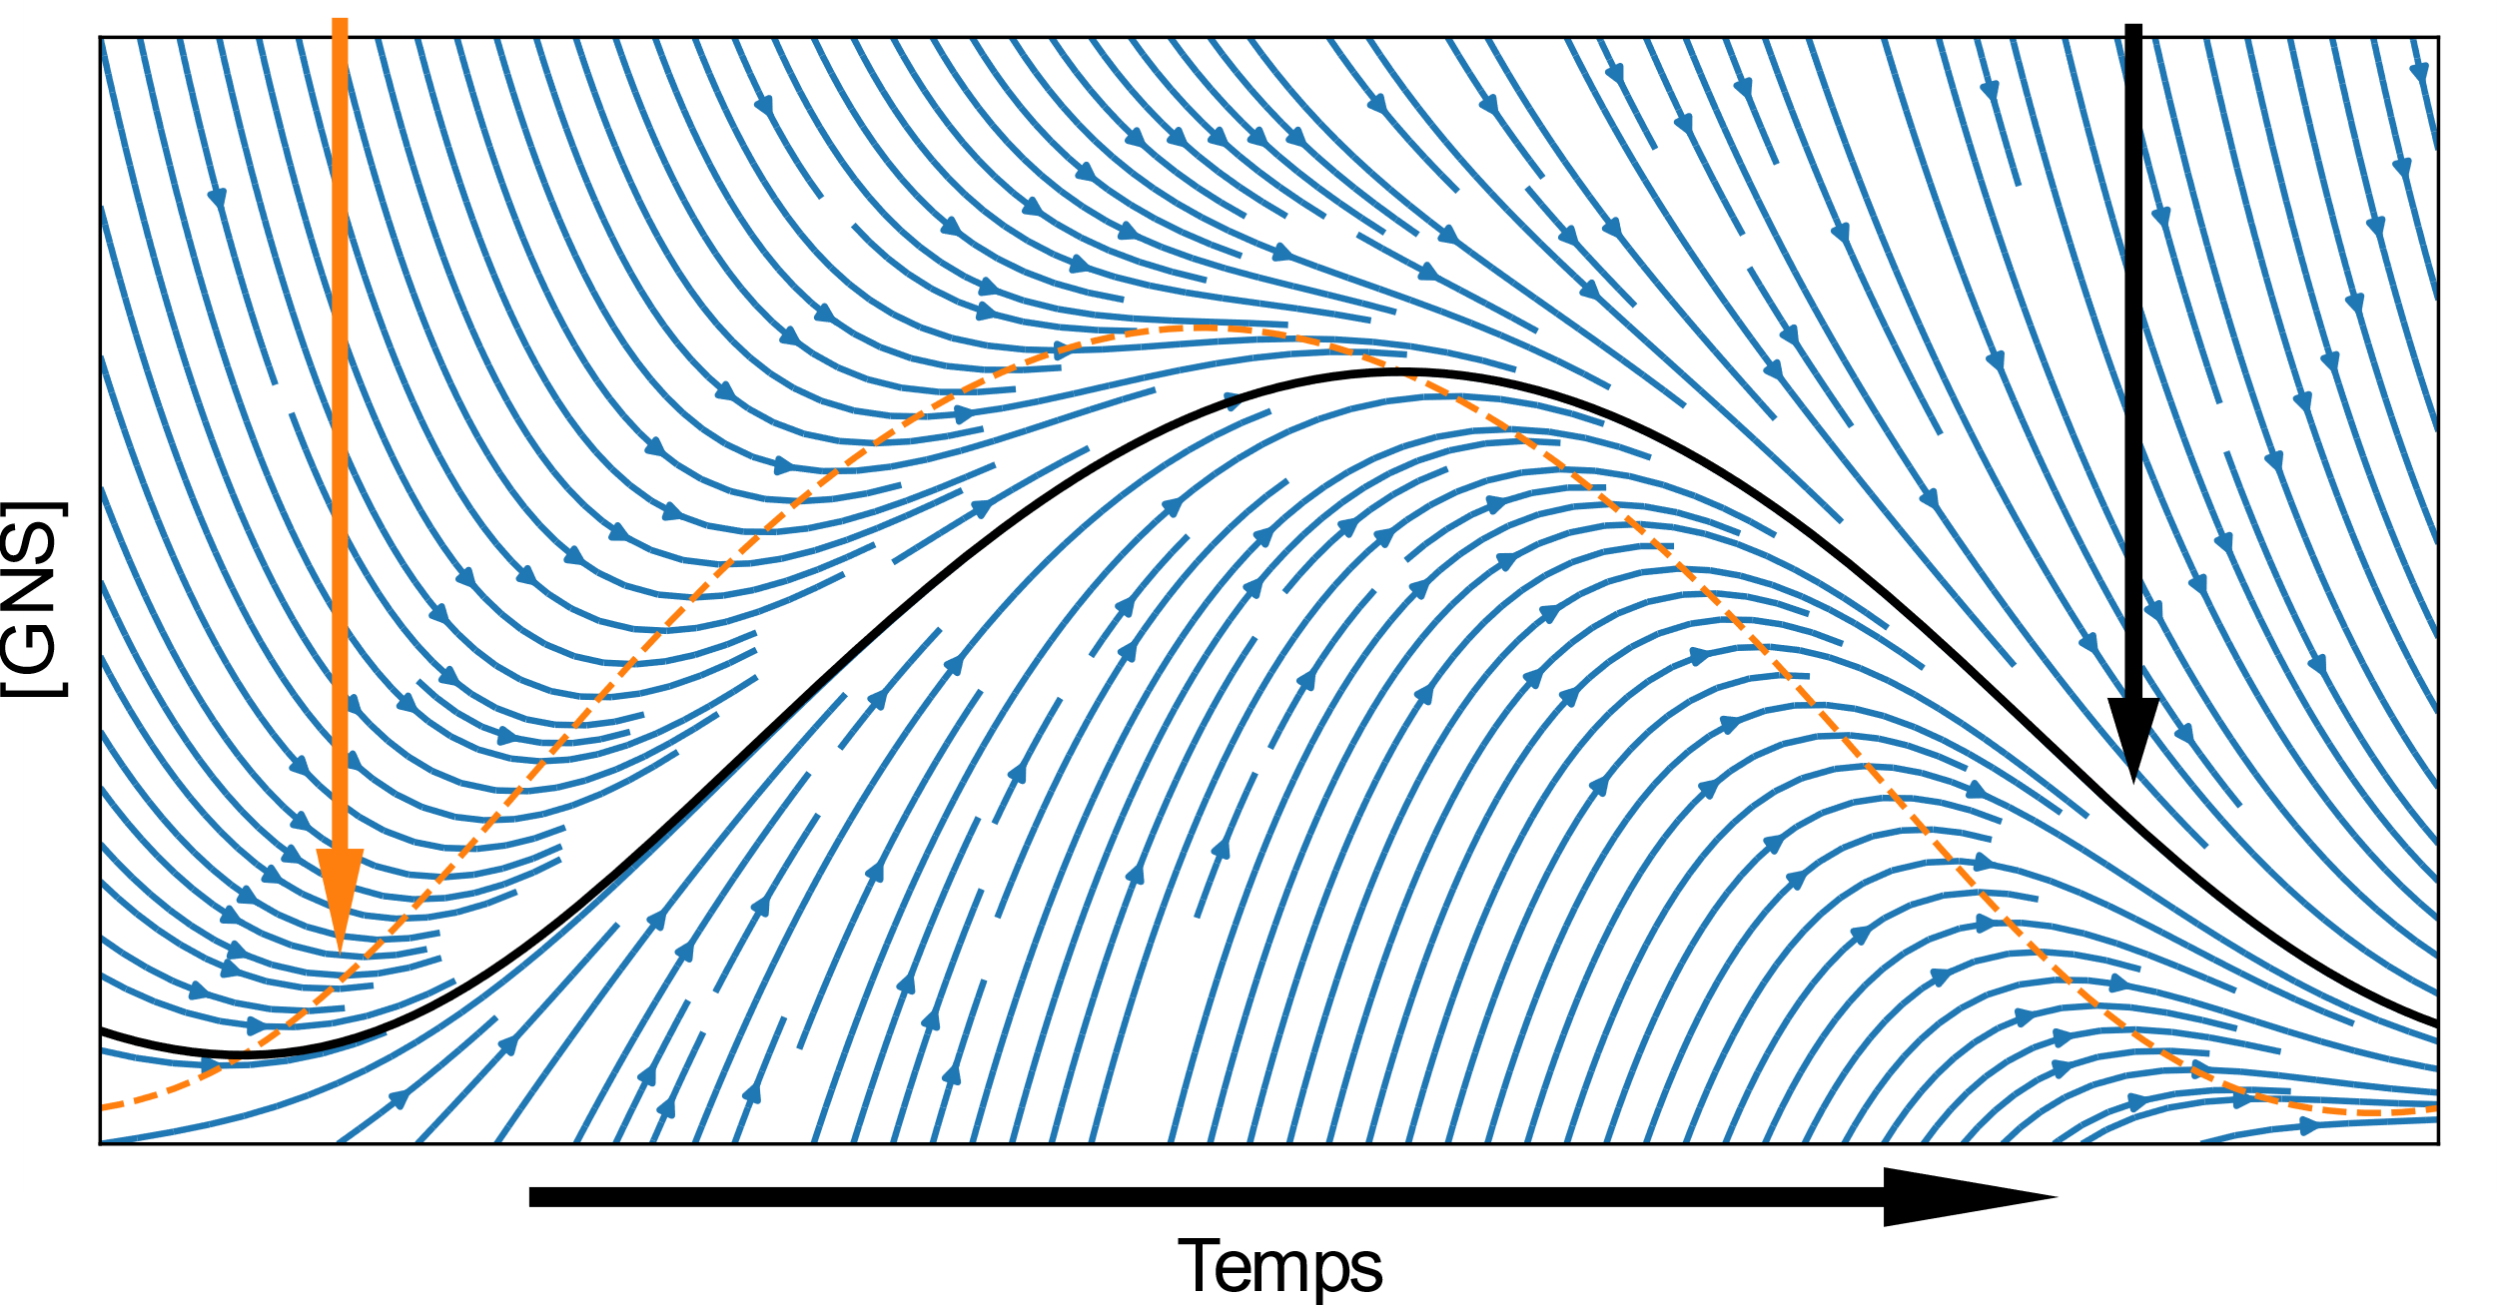
Balance point
Attractor
[NSC]
Time

Slide 8
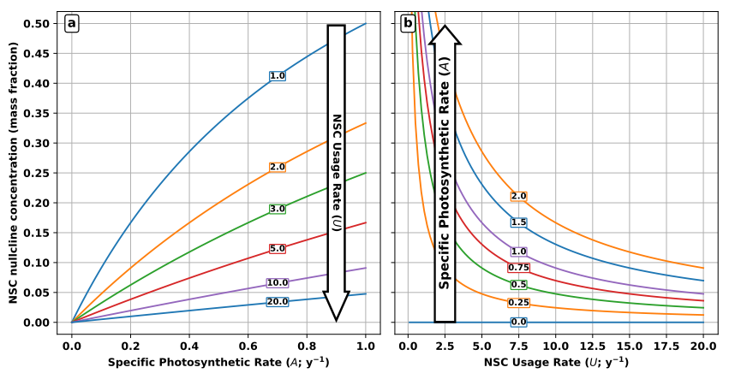
NSC balance point (mass fraction)

Slide 9
Supply driven
Demand driven

Slide 10
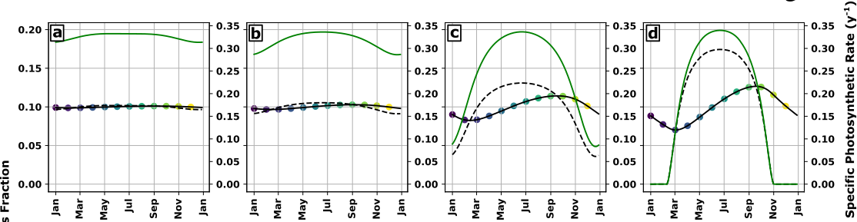
NSC (mass fraction)
Increasing seasonal amplitude of NSC supply

Slide 11
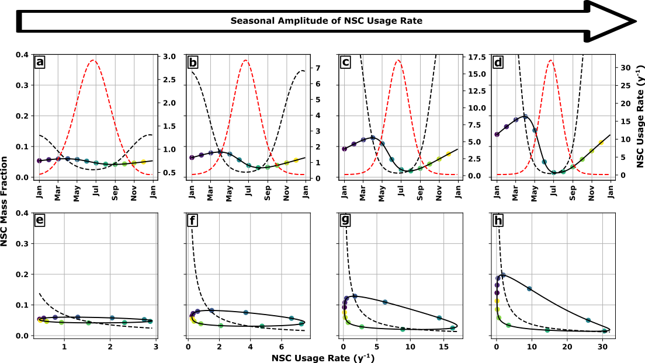
NSC (mass fraction)
Increasing seasonal amplitude of NSC demand

Slide 12
Supply driven
Demand driven
Fall max
Spring max

Slide 13
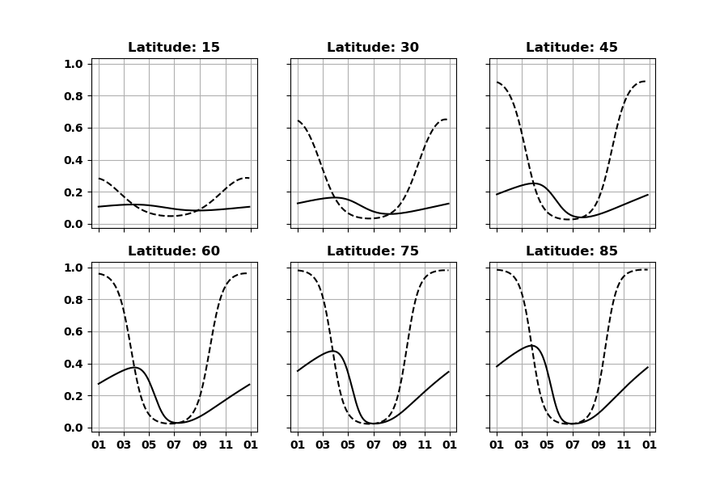

Slide 14
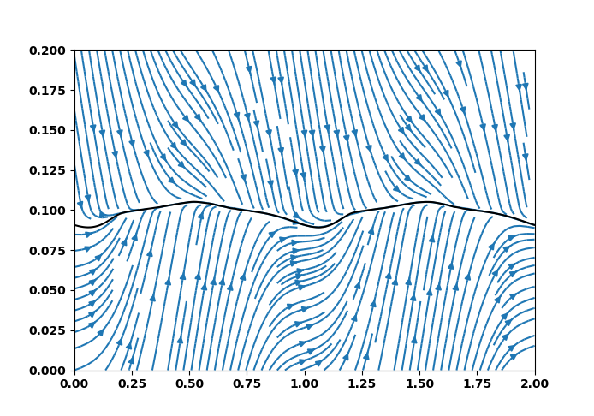
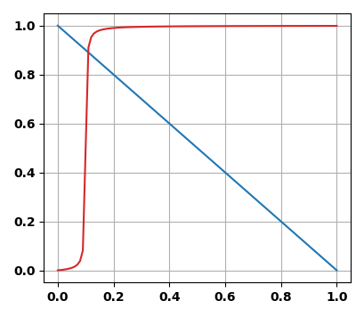
Homeostatic dynamics
Demand Rate
Supply Rate
NSC (mass fraction)
Time (y)

Slide 15
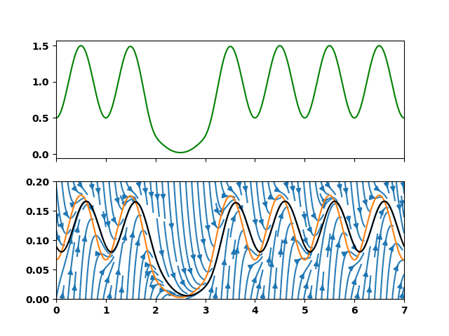
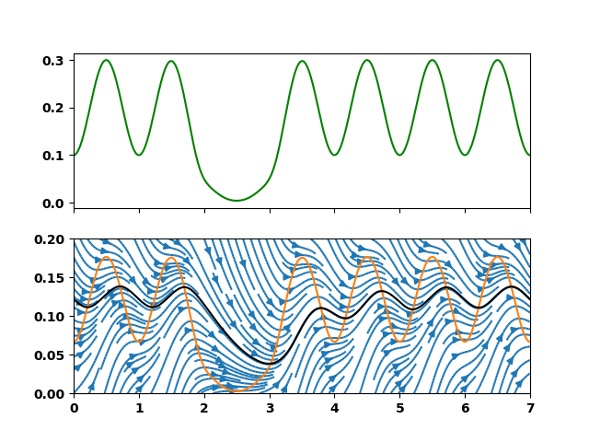
Supply rate
NSC (mass fraction)
Slower rate of supply and demand

Slide 16
Balance point
Attractor
[NSC]
Time

Slide 17
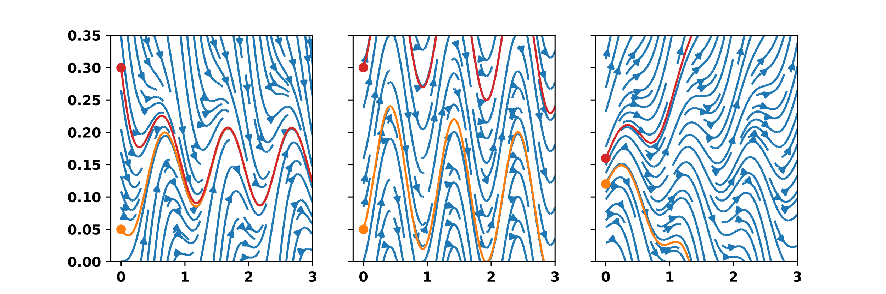
Stable
NSC (mass fraction)
Time (y)

Slide 18
Stable
Non Stable
NSC (mass fraction)
Time (y)
Time (y)

Slide 19
Stable
Non Stable
Unstable
NSC (mass fraction)
Time (y)

Slide 20
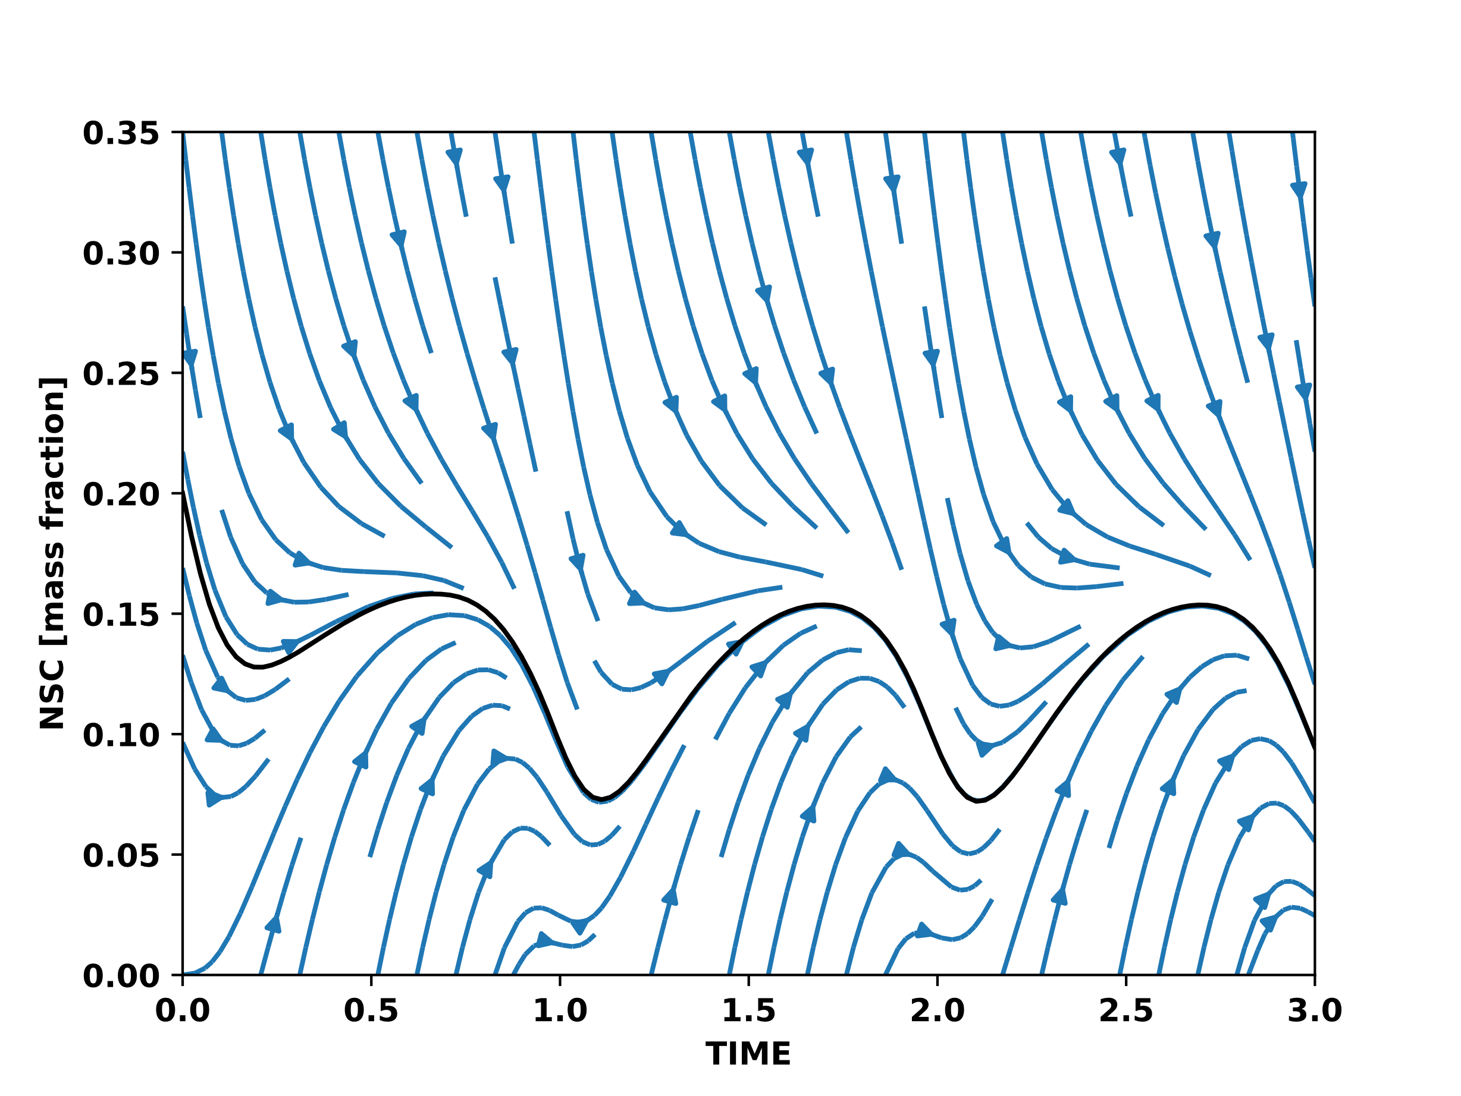
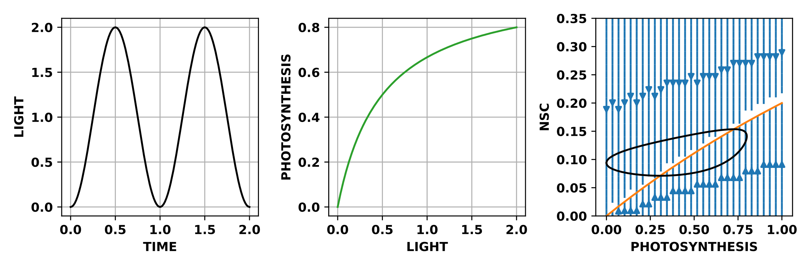
Stable for all environments

Slide 21
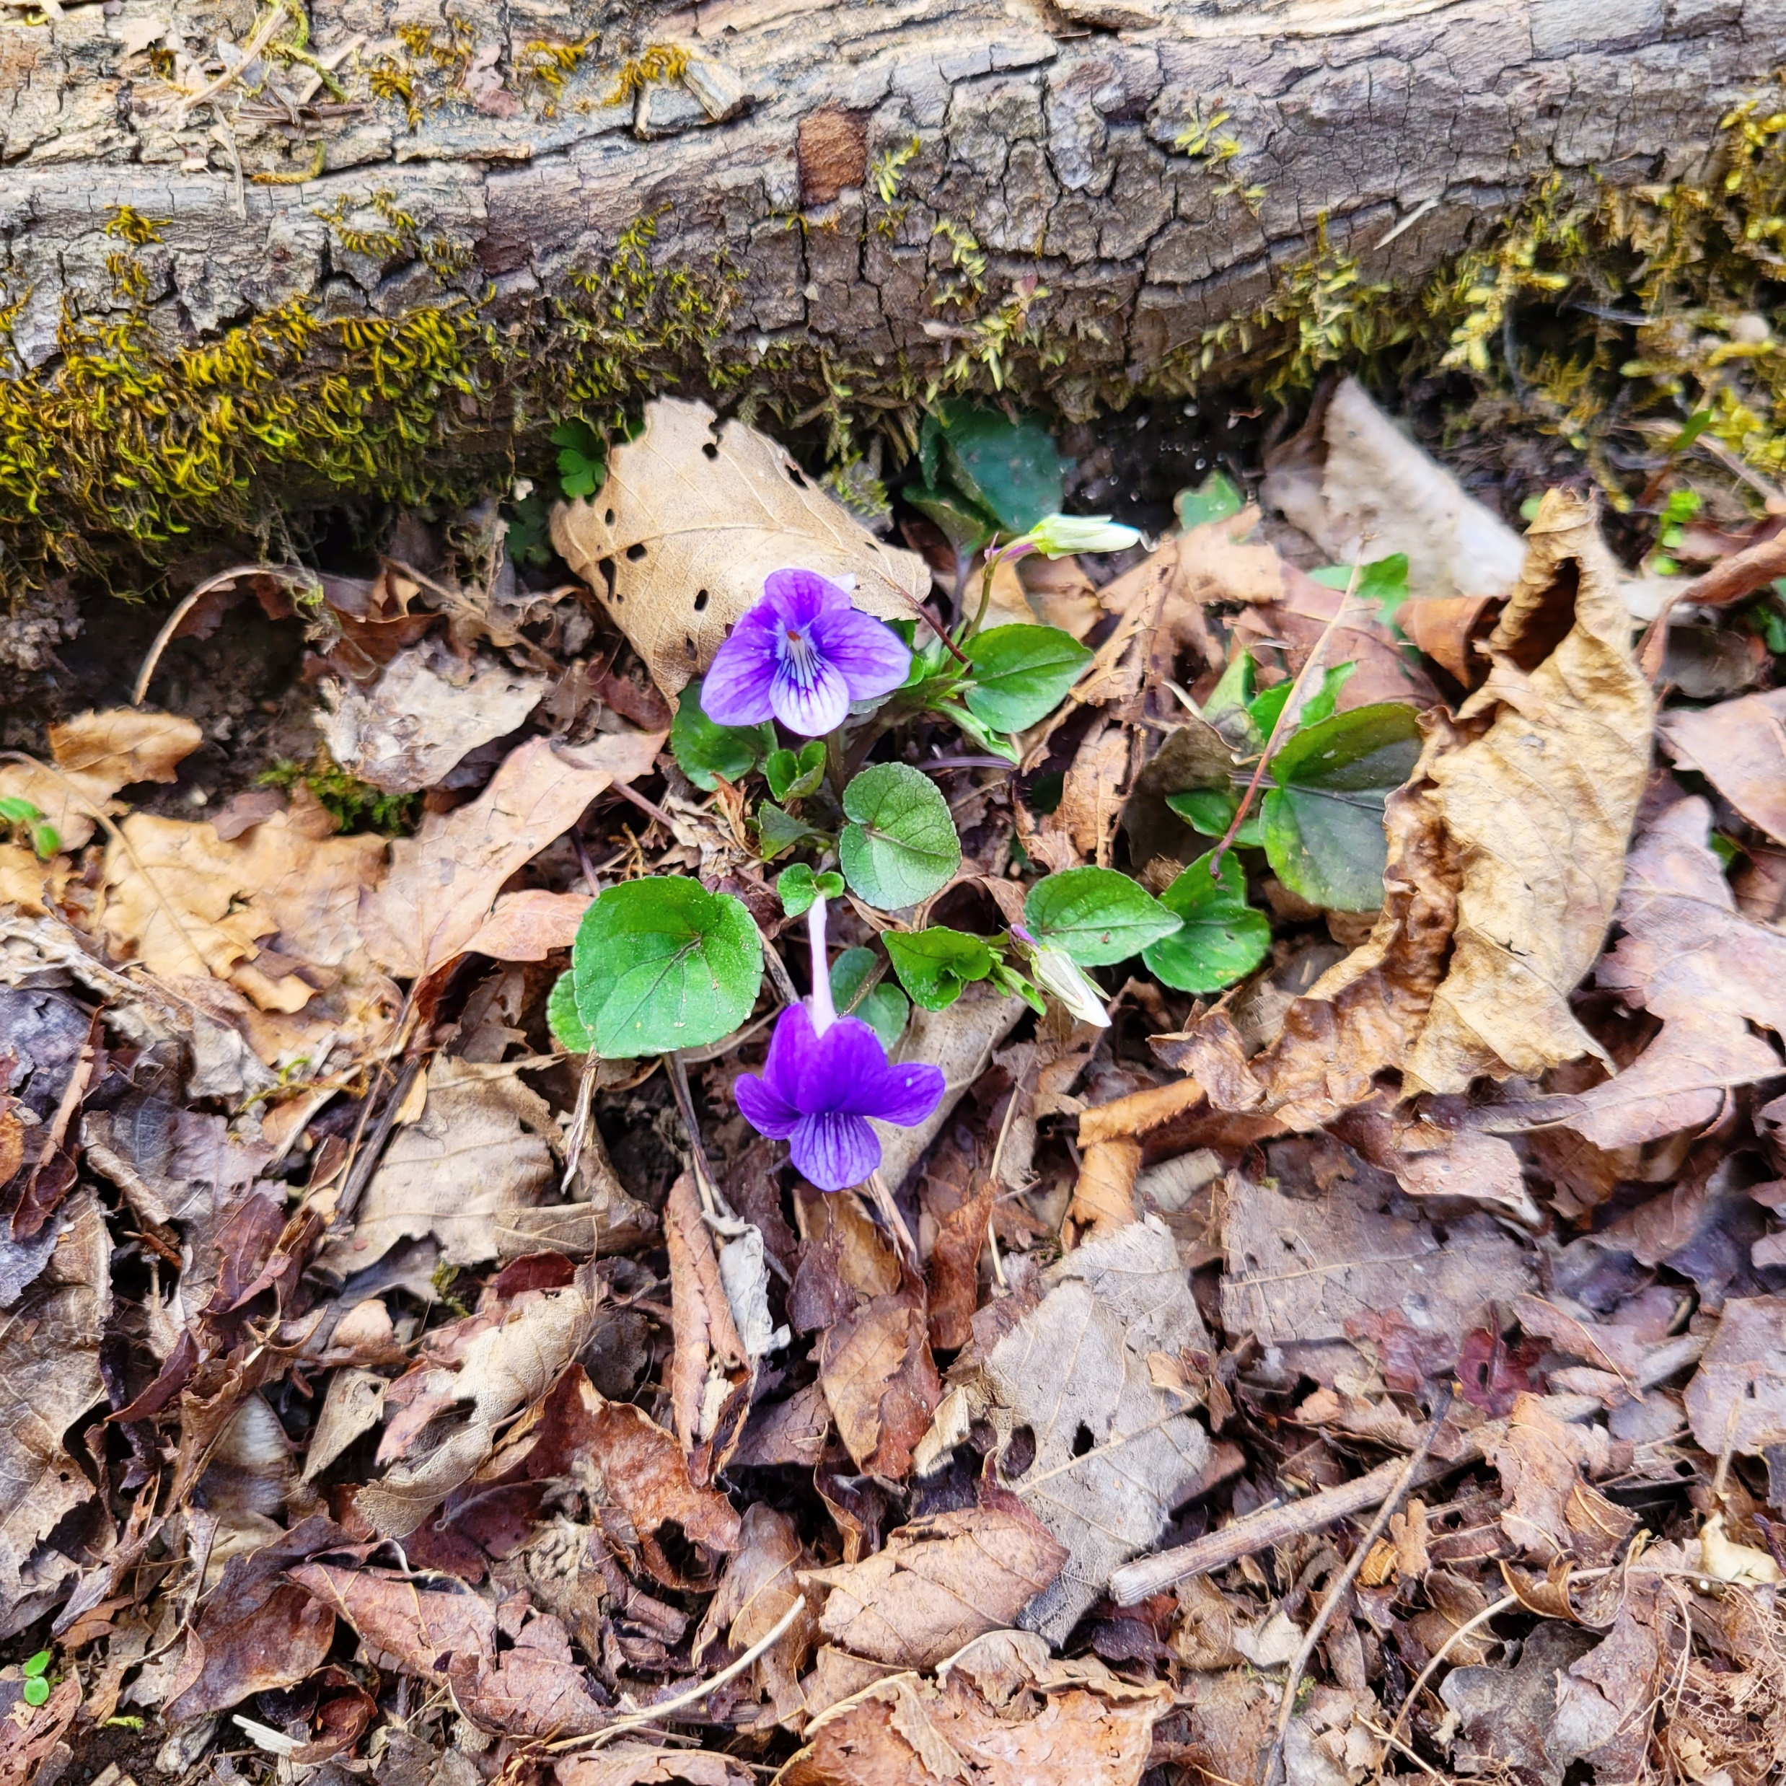
Summary
Stability → Attractor
Attractor → NSC feedback
Complex environment
→ Complex attractor

Slide 22
NSC balance point (mass fraction)

Slide 23
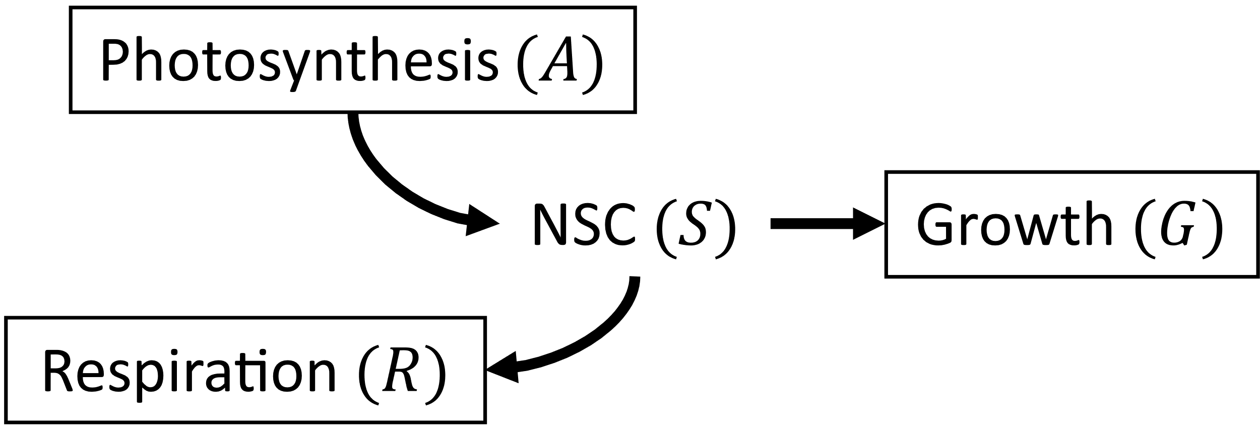
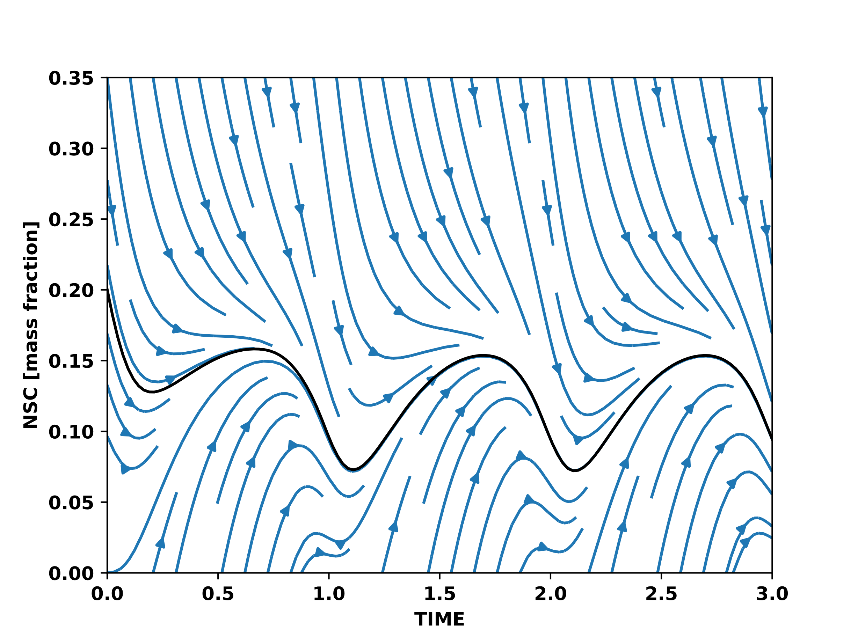
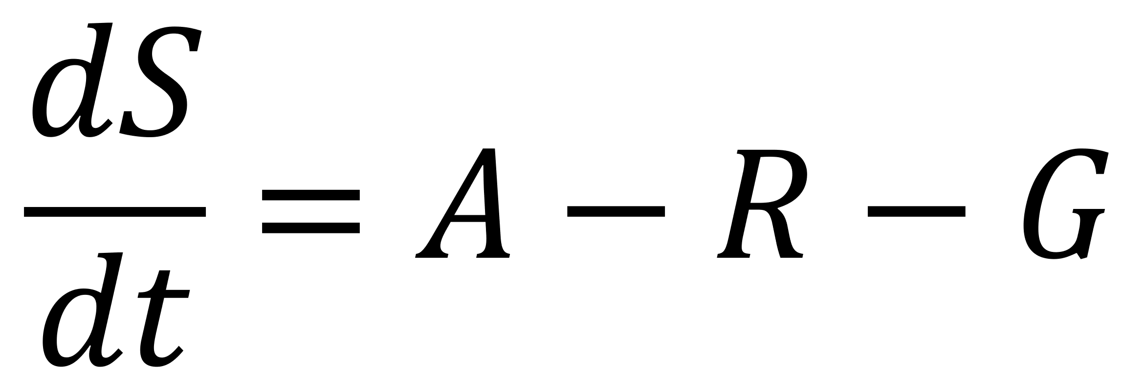
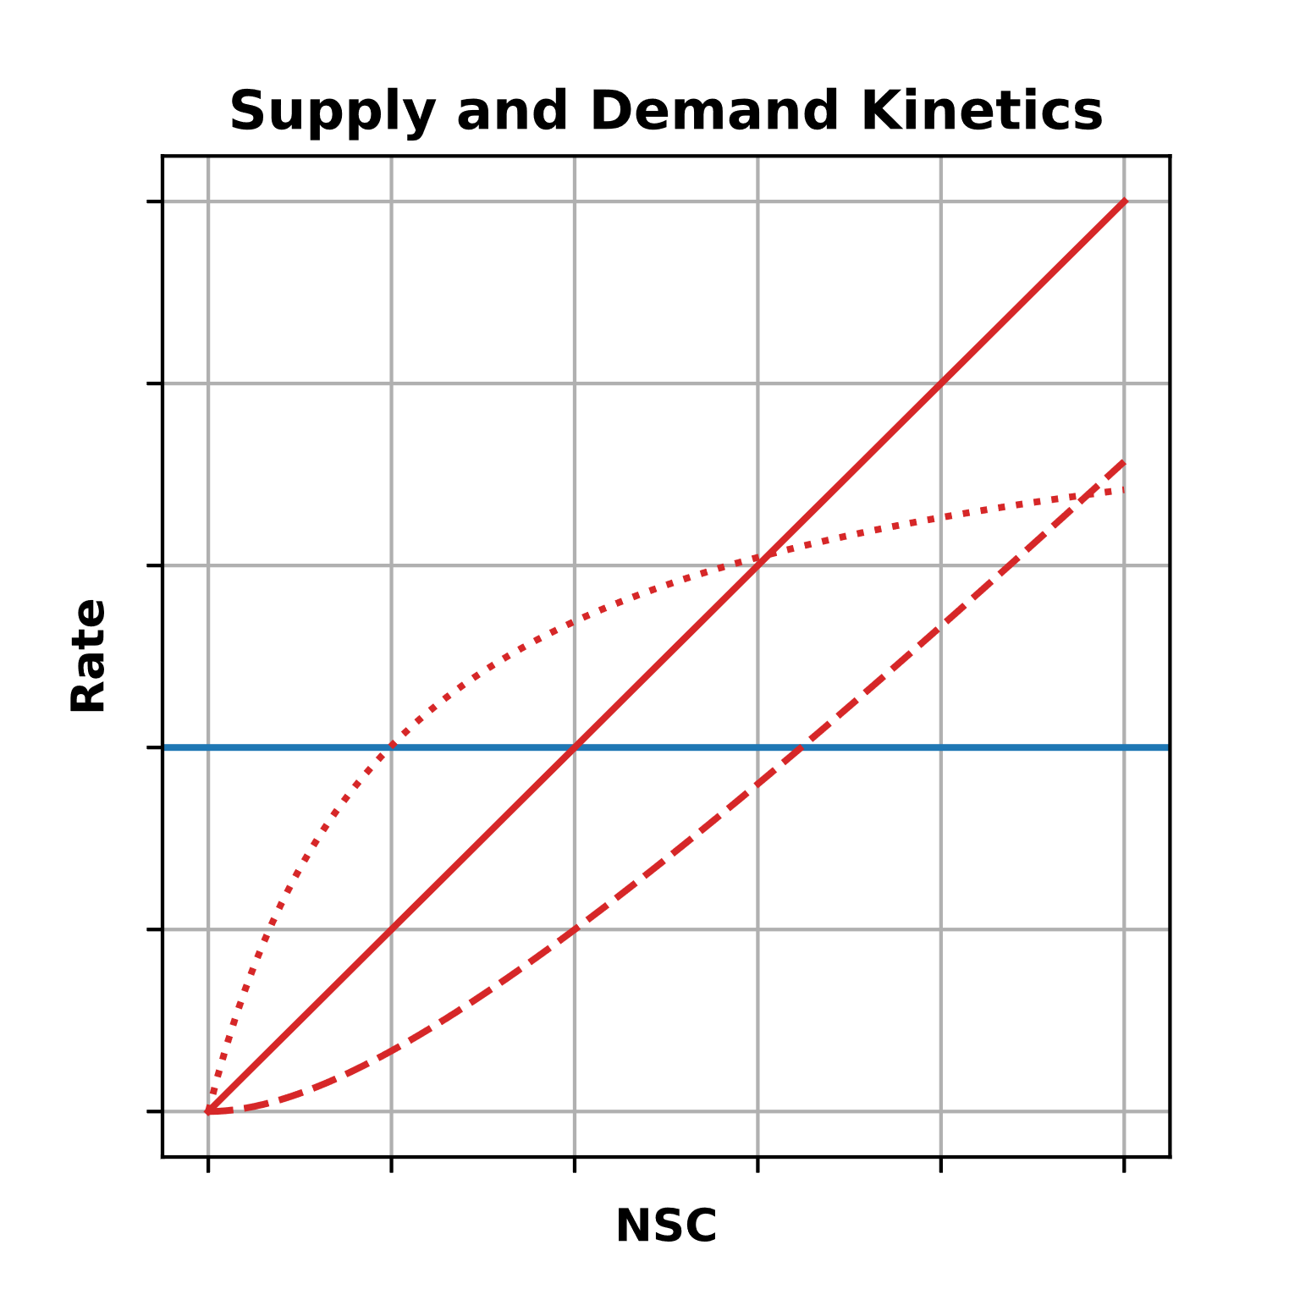

Slide 25
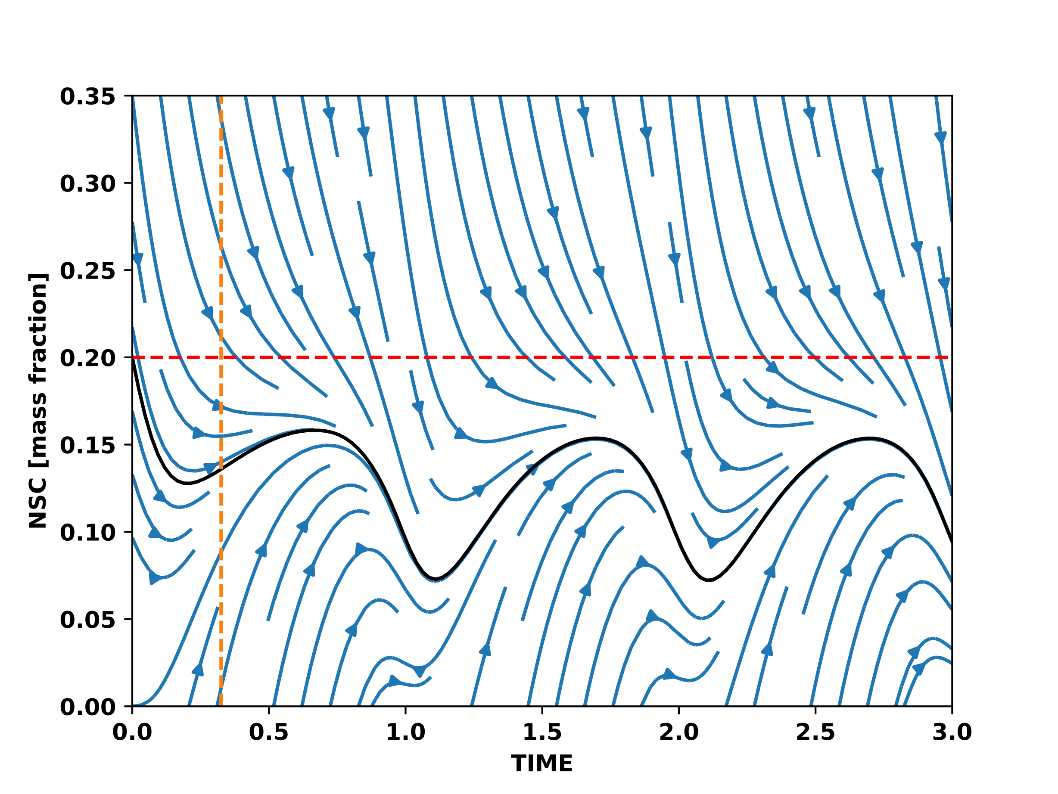
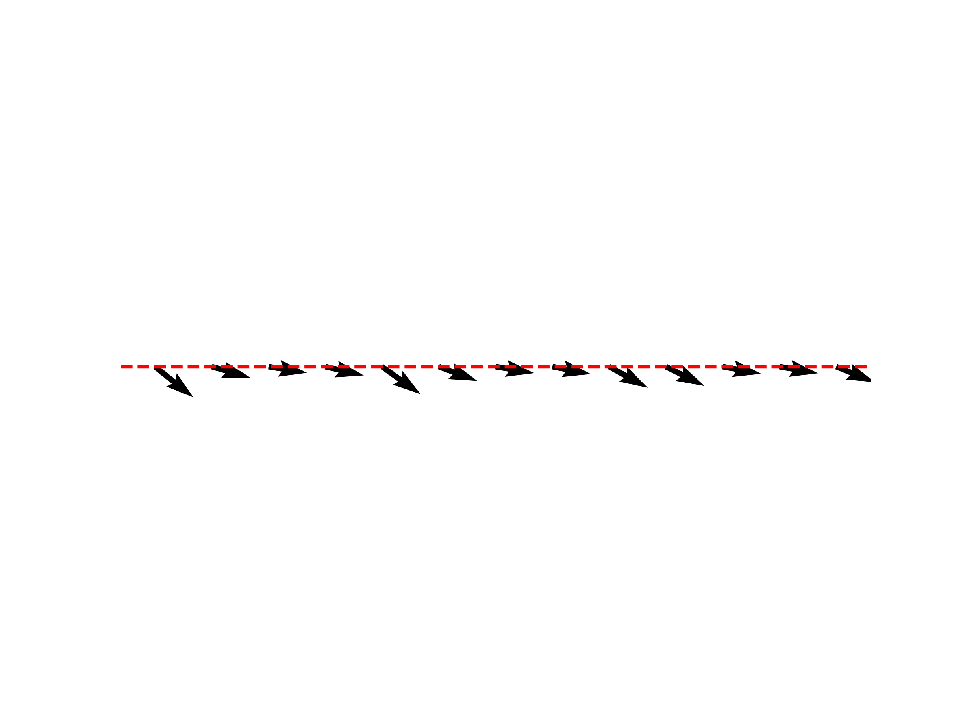
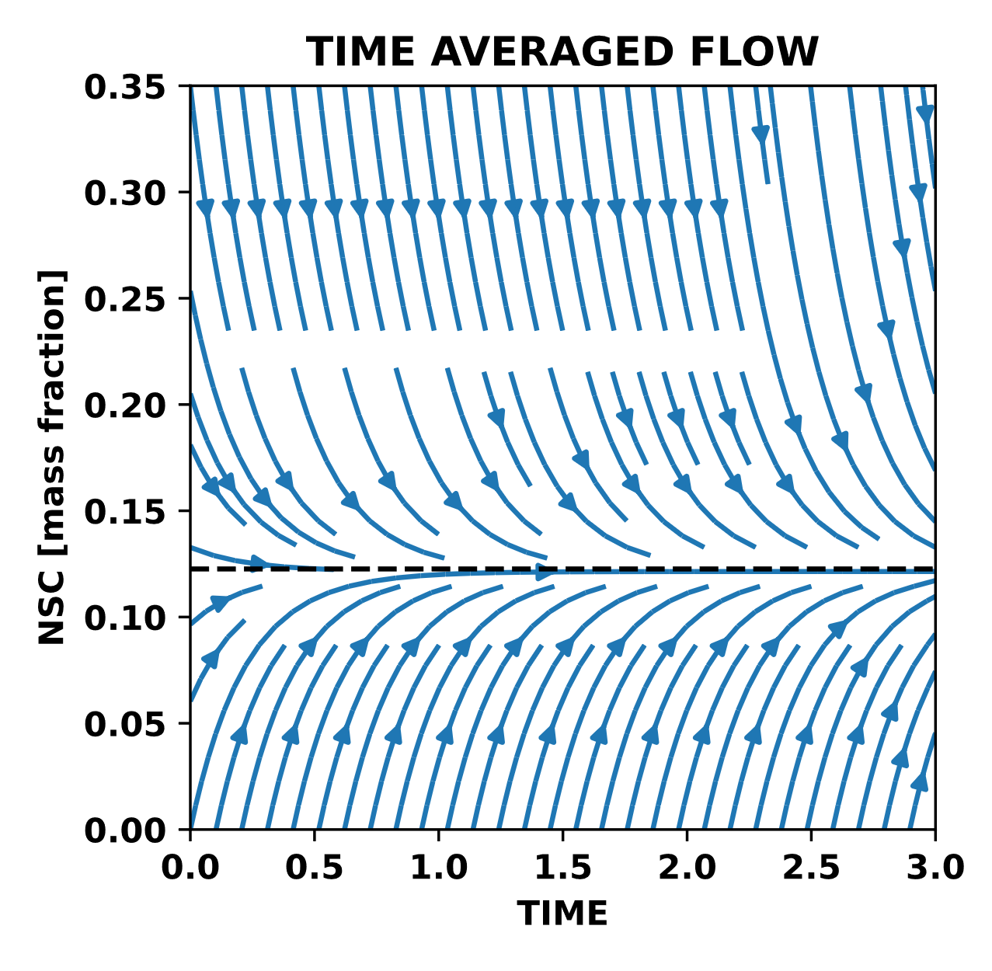

Slide 26
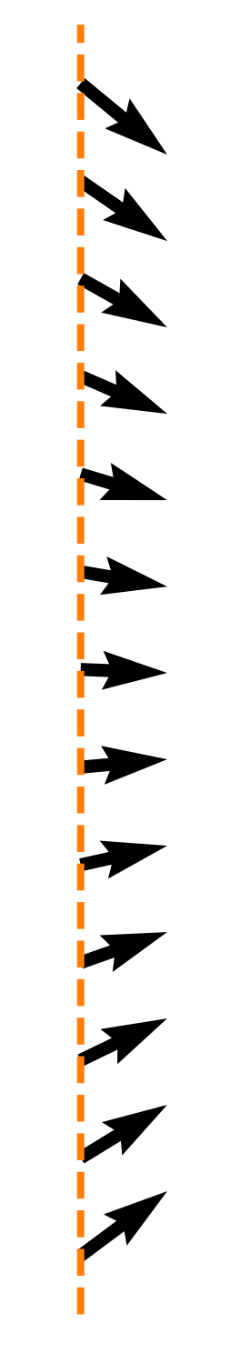

Slide 27
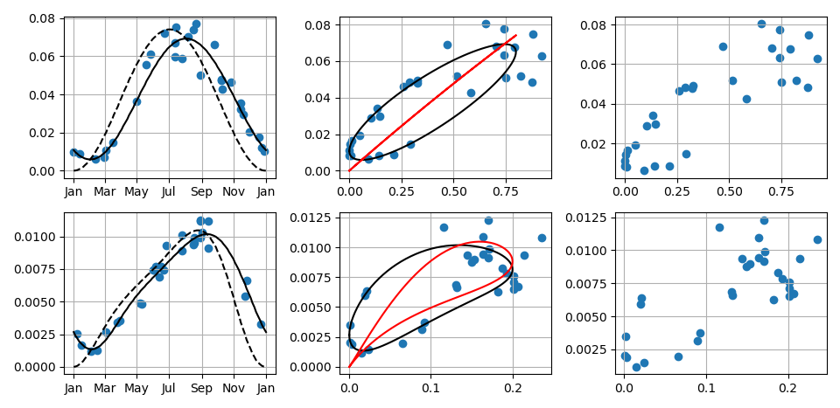

Slide 28
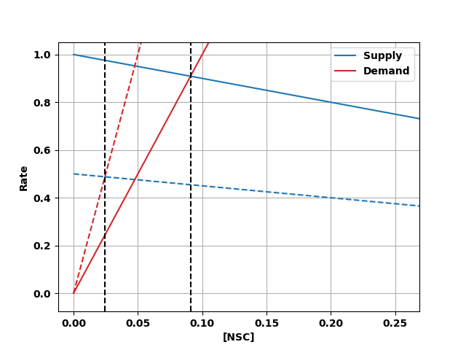
Photosynthesis = Supply
Adjustable
Respiration + Growth = Demand

